Slide 1
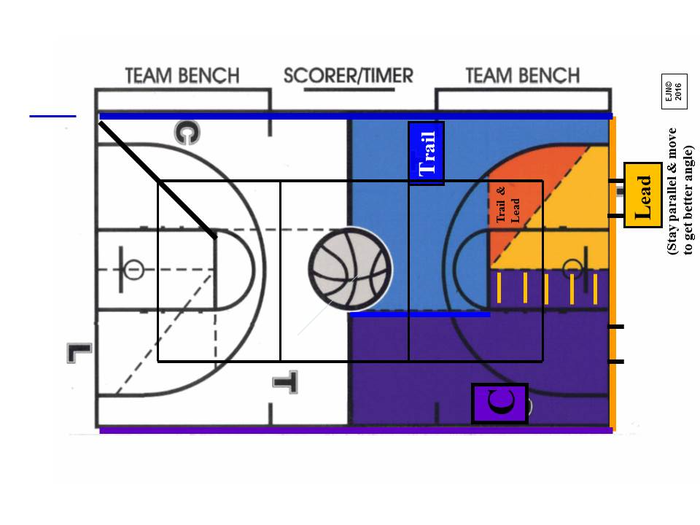
Center Official Coverage Topics
Starting position is free throw line extended, heels just off the sideline
Move up & down & in & out on the court as need to get proper angle,
especially on drives to basket from C’s primary, it’s C’s call, use “V” shaped movement to get position and best officiating angle
Don’t bail on shots: step down to cover rebound action
Don’t ball watch: strong C with off ball coverage is key
C should be last official to leave position on rotation: make sure other C is “locked in” at C before rotating to trail (2 C’s better than 2 Trails)
If shot originates from T, watch for basket interference & goaltending
Prepare to pick up closely guarded counts when released from Trail
On press coverage or after change of possession: Freeze & Assess
  Pause & Assess: set up where the defense sets up: Assess the defensive pressure and location of players and move accordingly
  Move to get best angle of vision to make the right call
  Be ready to call sideline to sideline
  Be ready to call over & back calls

