Slide 1
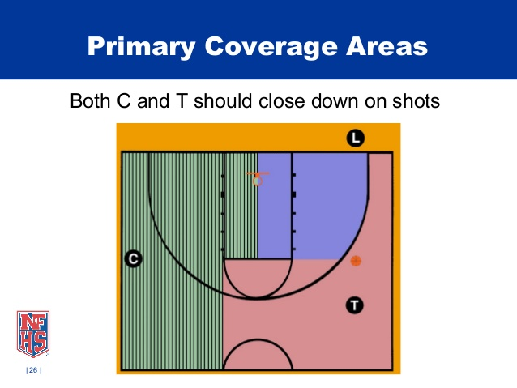
None of the Slides Change The Primary Coverage Areas Shown Here
Lead’s
Primary
Coverage
Area
Center’s
Primary
Covergae
Area
Trail’s
Primary
Coverage Area
40%
60%
Area Outside the lane between Trail and Center is split 60/40

Slide 2
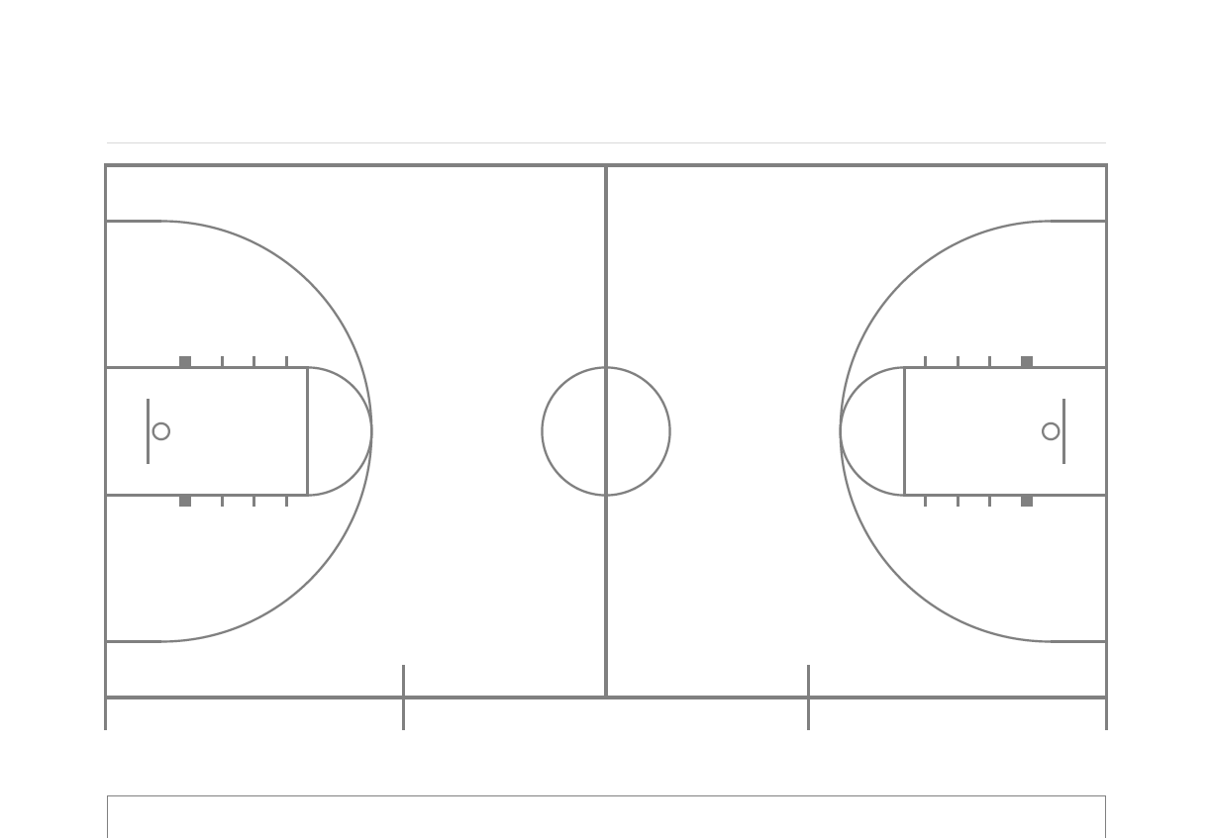



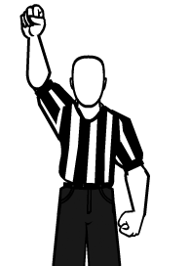

Who’s Call Is It?
Drive Originates From Trail’s Primary
Primary Responsibility
Who’s Call?
Trail’s Primary
60%
C’s Primary
40%
Team A Bench
Scorer’s Table
Team B Bench
It makes no difference if the C’s coverage in the lane area is displayed or not.
It has no bearing on the plays being presented originating from Trail’s primary.

Slide 3
Who’s Call Is It?
Drive Originates From Trail’s Primary
The 60/40 refers strictly to the primary area divide between
Trail and Center outside the lane area. In no way does this reflect any Primary Coverage Area between the Lead and the Center, which is not shown here. Look at the first slide for primary coverage areas!
Who’s Call?
Trail’s Primary
60%
C’s Primary
40%
Team A Bench
Scorer’s Table
Team B Bench

Slide 4
Who’s Call Is It?
Drive Originates From Trail’s Primary
Secondary
Responsibility
Primary Responsibility
Who’s Call?
Trail’s Primary
60%
C’s Primary
40%
Team A Bench
Scorer’s Table
Team B Bench
It makes no difference if the C’s lane area is displayed or not.
It has no bearing on the plays being presented.

Slide 5
Who’s Call Is It?
Drive Originates From Trail’s Primary
Trail’s Primary
Who’s Call?
60%
C’s Primary
40%
Team A Bench
Scorer’s Table
Team B Bench

Slide 6
Who’s Call Is It?
Drive Originates From Trail’s Primary
Trail’s Primary
Who’s Call?
60%
C’s Primary
40%
Team A Bench
Scorer’s Table
Team B Bench

Slide 7
Who’s Call Is It According To NFHS Mechanics Book?
Drive Originates From Trail’s Primary
Pg. 77 Mechanic D: This would be Trail’s Call by the NFHS book, “even if the ball moves into another official’s primary area.” This is NOT C’s primary call. This drive started in Trail’s Primary, not Center’s.
Trail’s Primary
Who’s Call?
60%
C’s Primary
40%
Team A Bench
Scorer’s Table
Team B Bench
In Ohio, The DOD has directed that as the ball gets deeper into the “paint”, it transitions to the Lead’s call. Center would have last responsibility.

Slide 8
Who’s Call Is It?
Drive Originates From C’s Primary
Trail’s Primary
Who’s Call?
60%
C’s Primary
40%
Team A Bench
Scorer’s Table
Team B Bench

Slide 9
Who’s Call Is It?
Shot Is Missed, Foul Occurs on Rebound
Trail’s Primary
60%
C’s Primary
Who’s Call?
40%
Team A Bench
Scorer’s Table
Team B Bench

Slide 10
Who’s Call Is It?
Shot Is Missed, Foul Occurs on Rebound
Who’s Call?
Trail’s Primary
60%
C’s Primary
40%
Team A Bench
Scorer’s Table
Team B Bench

Slide 11
Who’s Call Is It?
Shot Is Missed, Foul Occurs on Rebound
Trail’s Primary
Who’s Call?
60%
C’s Primary
40%
Team A Bench
Scorer’s Table
Team B Bench

Slide 12
Who’s Call Is It?
Shot Is Missed, Foul Occurs on Rebound
Primary
Responsibility
Secondary
Responsibility
Who’s Call?
Trail’s Primary
60%
C’s Primary
40%
Team A Bench
Scorer’s Table
Team B Bench

