Slide 1

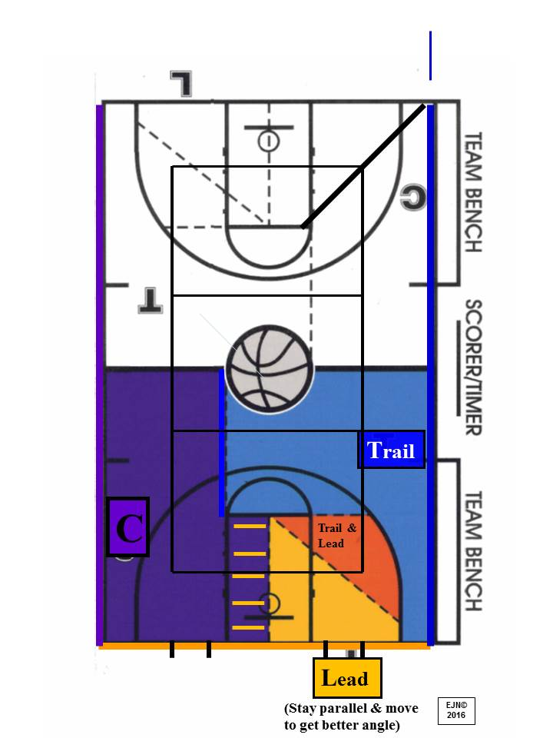
R I S I N G S T A R O F F I C I A T I N G C A M P
Court Coverage Diagram
X
X
X
X
X
X
X
X
X – Inbound Spots
Rising Star Officiating Camp | Court Coverage Reference

