Slide 1

High School Shot Clock Rules
And Procedures
Adopted from the National Federation Guidelines for Shot Clock Use in High School Basketball
- Prepared on behalf of The BATTLE Series by -
Dave DeAngelo
Senior Associate Director - Facilities
Office of Student Life Recreational Sports
Steve Furniss
Official Scorer Men’s and Women’s Basketball, Capital University
Official Scorer Men’s and Women’s Basketball, Ohio Dominican University

Slide 2
Rules and Procedures
The shot clock in high school games is 35 seconds.
The shot clock is used in each quarter and overtime period.
The shot clock operator should be located at the scorers table adjacent to the game clock operator and official scorer. It is recommended they be seated next to the game clock operator.
An alternate timing device (a stopwatch and air horn are good options) and procedure should be available in the event of a clock failure.
The shot clock buzzer/horn should be audibly different from the main clock buzzer/horn.

Slide 3
Rules and Procedures
The shot clock horn does not stop play unless recognized by an official’s whistle, EVEN IF THE HORN SOUNDS.
Allow the game officials to make the final decision when there is doubt as to whether the score was made within the shot clock period or the whether a try for goal contacted the rim or flange.
Be PATIENT when resetting the shot clock. It is easier to fix the time on a shot clock that should have been reset than one that should not have been reset!

Slide 4
Rules and Procedures
When an obvious mistake by the shot clock operator has occurred in failing to set or reset the shot clock, the mistake may be corrected in the shot clock period in which it occurred only when the referee has definite information relative to the mistake and time involved.
Some systems may have a “recall” feature that will allow the clock to reset to the previous time. If recall is unavailable, utilizing the game clock and input from other table personnel may help.

Slide 5
Rules and Procedures
The shot clock will stop when the game clock is turned off
  NOTE: The shot clock and game clock must be synchronized to prevent the shot clock from running when the game clock is not.
TURN OFF the shot clock when the game clock is LESS than 35 seconds and there is a reset situation

Slide 6
Definitions – understanding team control is crucial
These definitions related to possession or control are required for efficient shot clock operation
  A player is in control when they are holding or dribbling a live ball inbounds.
  A team is considered in control when a player of that team is in control, a live ball is passed between teammates including when a pass is muffed by the receiving teammate, a of that team has the ball for a throw-in, and during an interrupted dribble or loose ball.
  Team control will continue until the ball is in flight during a try for goal, an opponent secures control, or the ball becomes dead.

Slide 7
Definitions – understanding team control is crucial
Player/team control continued
  There is no player/team control during;
  A jump ball;
  The tapping of a rebound, unless it is a try for goal;
  A try for goal while the ball is inflight, or the time while the ball is trying to be secured by each team to gain control;
  A dead ball.

Slide 8
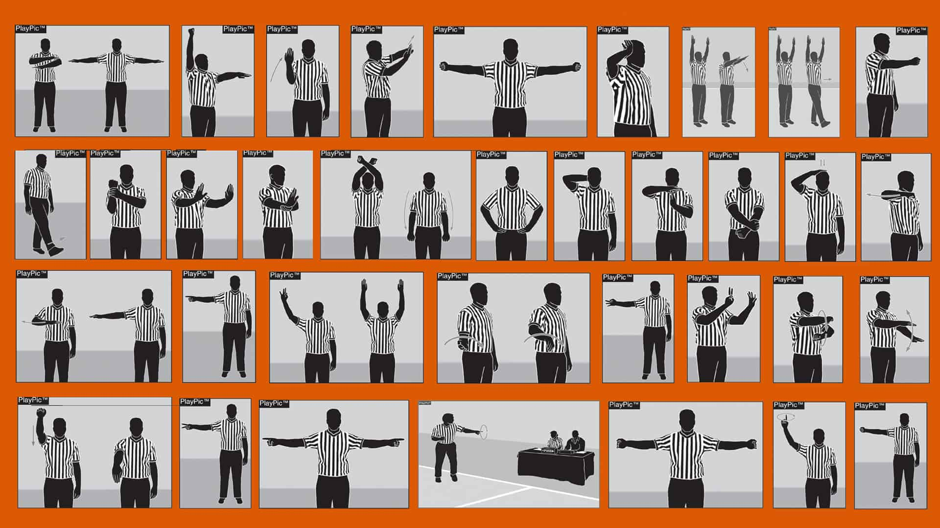
Officials' signals
This signal means to reset the shot clock. It can be given during live action without a whistle or stoppage of play.
  RULES EXCEPTION: In the event of a kicked or fisted ball, if the shot clock is below 20 seconds, the clock will be rest to 20 seconds. The official will signal the number 20 to the table.

Slide 9
Officials' signals
This signal means a violation has occurred. It is proceeded by the shot clock horn, followed by the official’s whistle.
The timer will rest the shot clock to 35 seconds, and play will resume with an inbounds throw.

Slide 10
When does the shot clock start
The shot clock will start when possession is established following:
  A jump ball that starts the game or any overtime period
  An official signals the clock to start when touched by a player on a throw-in.
    NOTE: Unless otherwise directed by the state association, officials should use the time on the shot clock to determine a 10 second backcourt violation.

Slide 11
When does the shot clock reset
The shot clock will be reset to 35 seconds when:
  There is a change of possession with a new team in CONTROL
  There is a single personal foul
  There is a single technical foul on the defensive team
  A try/tap (not a pass) contacts the rim/flange and either team gains possession
    NOTE: a try that hits the backboard only and not the rim or flange does not necessitate a reset.

Slide 12
When does the shot clock reset
The shot clock will be reset to 35 seconds when:
  There is an inadvertent whistle with no team in control
  If a held (jump) ball occurs and a change of possession takes place
  If a try/tap FAILS to hit the ring/flange and is recovered by the other team
  When a try/tap lodges against the basket and backboard

Slide 13
When does the shot clock NOT reset
The shot clock will be allowed to continue to run when:
  Any loose ball situation
  During a try for goal that does not score a basket and does not hit the rim/flange
  When a try for goal is attempted at the wrong basket
  During a loose ball when the OFFENSE maintains possession

Slide 14
When does the shot clock NOT reset
The shot clock will be allowed to continue to run when:
  The defensive team touches the ball but does not gain CONTROL
  A blocked try/tap does not hit the rim/flange and is recovered by the OFFENSIVE team
  A try/tap FAILS to hit the rim/flange and is recovered by the OFFENSIVE team.

Slide 15
When does the shot clock NOT reset
The shot clock will not be reset and will resume when the game clock again begins to run:
  The OFFENSE retains possession of a held ball
  The OFFENSE retains possession on an out of bounds violation
  There is an injured player for either team
  There is a time out called by either team or official

Slide 16
When does the shot clock NOT reset
The shot clock will not be reset and will resume when the game clock again begins to run:
  A double foul occurs
  There is a technical foul on the offensive team
  There is an inadvertent whistle with team control

Slide 17
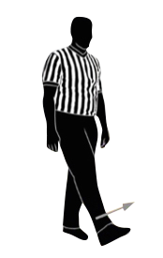
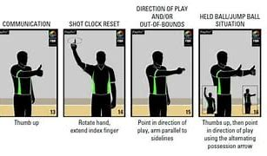
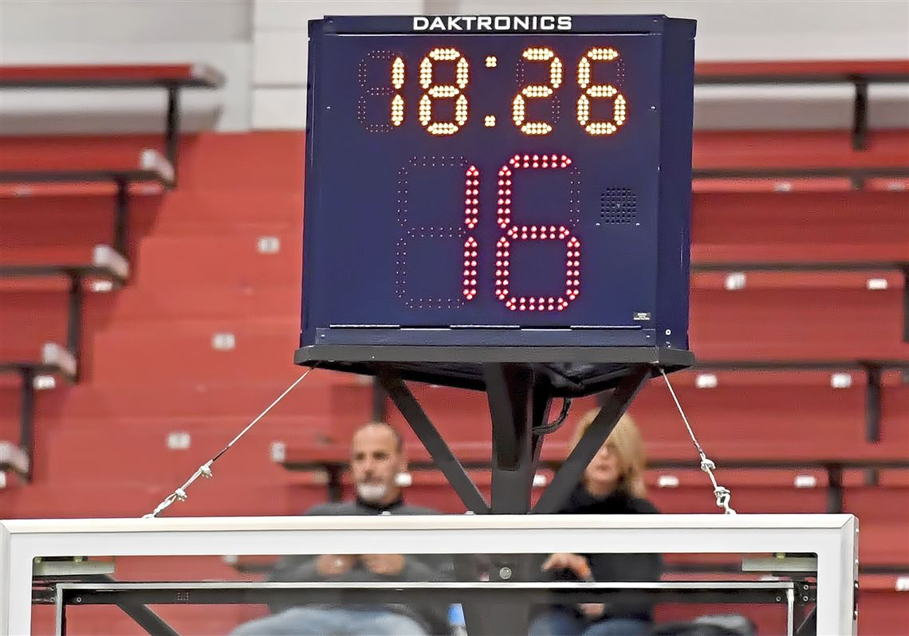
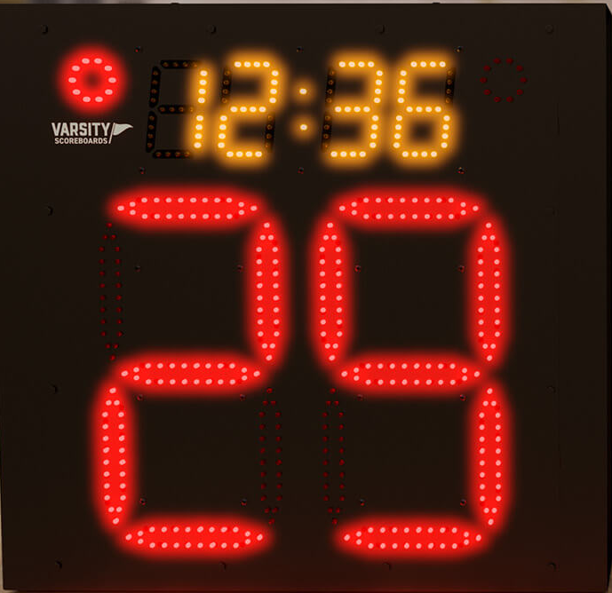
Special Situations
  Kicked/ Punched ball exception
    Reset to 20 seconds if the shot clock is LESS than 20 seconds.
    Do NOT rest the shot clock if the shot clock shows 20 seconds or greater

Slide 18
Play Situation Videos

Slide 19
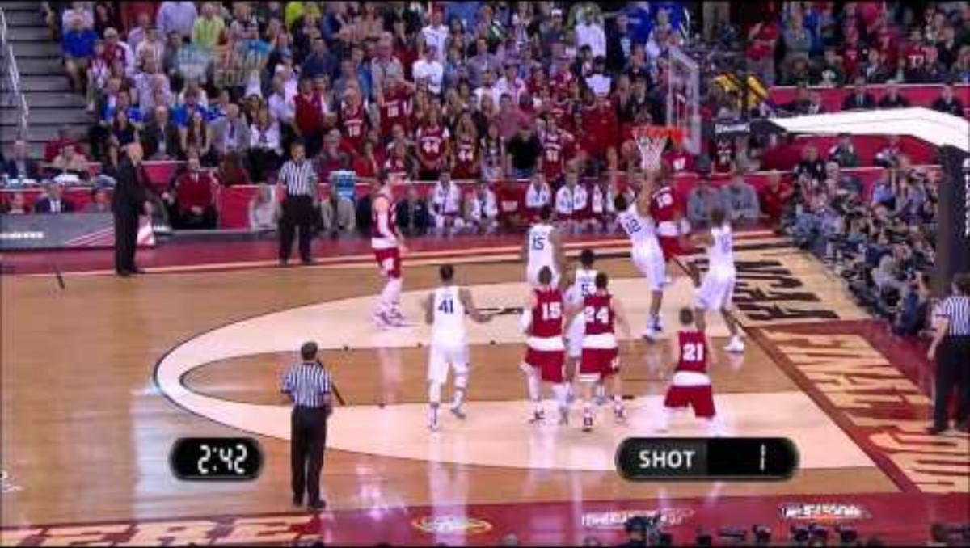

Slide 20
What happened on this play?
What should the officials do on this play?
Play should have been stopped and called a shot clock violation. It appears the official may have gotten wrapped up in the shot and rebound and missed the shot clock. It’s easy in a loud environment to miss the sound of the shot clock. Be sure to review this in the pregame meeting with the table.
What should the Shot Clock Operator do on this play?
The shot clock operator should not do anything here. Let the shot clock horn/buzzer sound until its clear the goal is good and or the officials have decided to let the play continue.

Slide 21
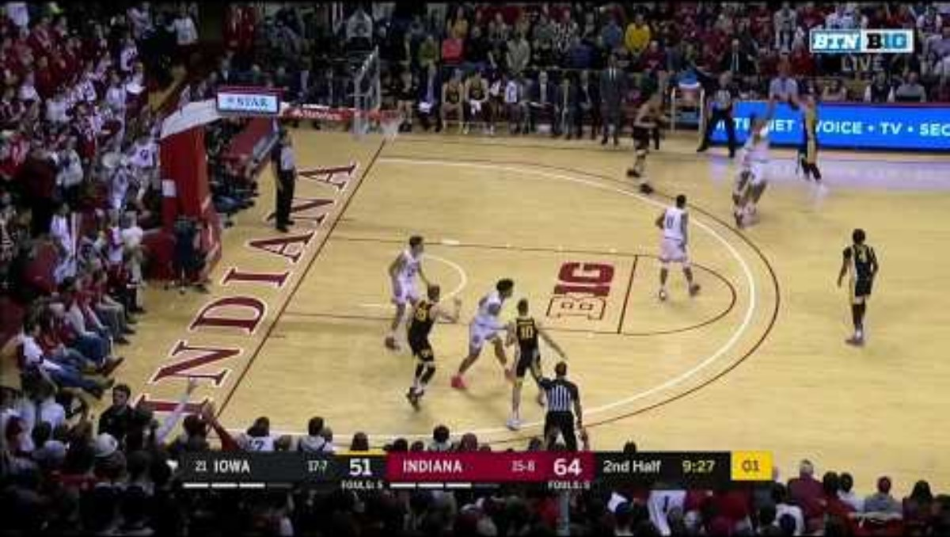

Slide 22
What happened on this play?
What should the officials do on this play?
It’s clearly a shot clock violation. The defense did catch the rebound, so you could say no harm no foul, play on. However, you should consider that several things can occur on a throw-in. You should get clarification from your coordinator on current administration of this play.
What should the Shot Clock Operator do on this play?
The shot clock operator should not do anything here. Let the shot clock horn/buzzer sound until its clear the officials have decided to let the play continue.

Slide 23
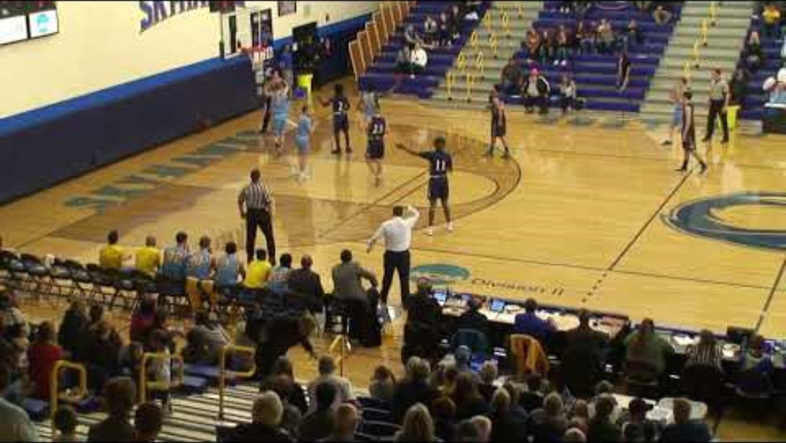

Slide 24
What happened on this play?
What should the officials do on this play?
There are several possibilities here. Could it have been a charging foul (not called). Could it have been a loose ball recovered by the defense and then lost OB (Reset the shot clock). Could it have simply been a loose ball OB, and the defense gets the ball. Could it have been a shot clock violation, and the defense gets the ball?
What should the Shot Clock Operator do on this play?
Wait for the officials to finish their discussion and the follow their direction on the shot clock. Don’t be afraid to ask them. Get the timer to get their attention using the horn before allowing the ball to be put in play if necessary.

Slide 25
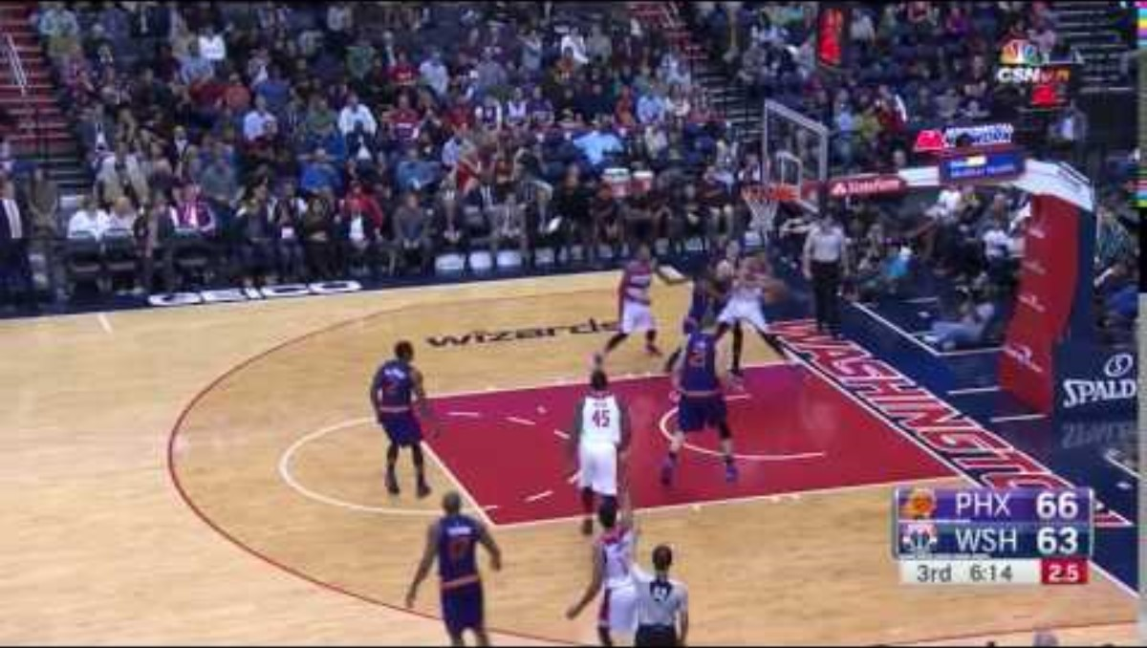

Slide 26
What happened on this play?
What should the officials do on this play?
On this play, the official signals that he wants the play to be reviewed. We don’t have replay at the HS level, so we must get this call. It’s clear it’s a violation.
What should the Shot Clock Operator do on this play?
The shot clock operator should not do anything here. Let the shot clock horn/buzzer sound until its clear the goal is good and or the officials have decided to let the play continue.

Slide 27
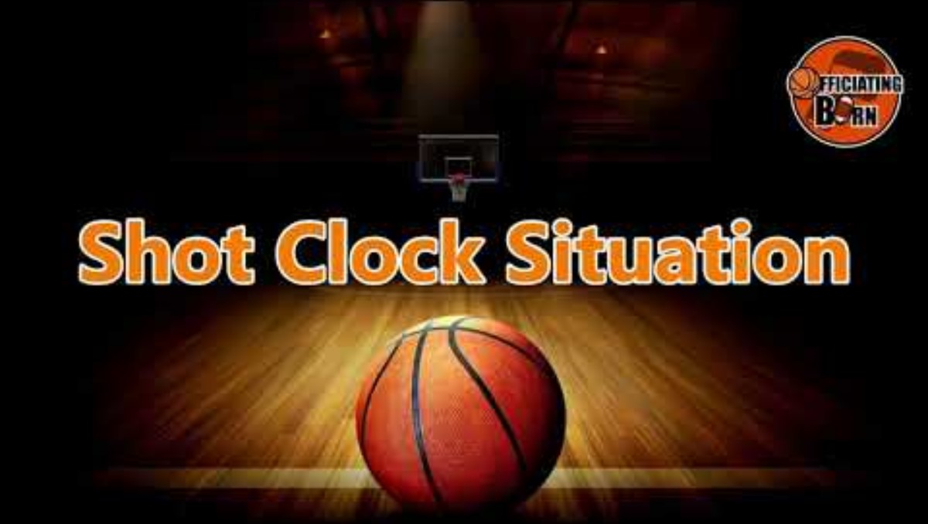

Slide 28
What happened on this play?
What should the officials do on this play?
Play should have been stopped and called a shot clock violation. It appears the shot is late, so it is a violation. A blocked shot does not reset the clock.
What should the Shot Clock Operator do on this play?
The shot clock operator should not do anything here. Let the shot clock horn/buzzer sound until its clear the officials have decided to let the play continue.

Slide 29
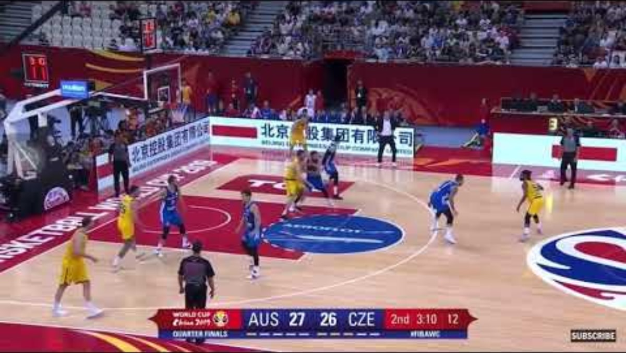

Slide 30
What happened on this play?
What should the officials do on this play?
The official called a foul on this play. If no foul is called then, it is simply a shot clock violation
What should the Shot Clock Operator do on this play?
The shot clock operator should react to the call made by the officials. In both cases, foul or shot clock violation, in HS the clock will be set to 35 seconds.

Slide 31
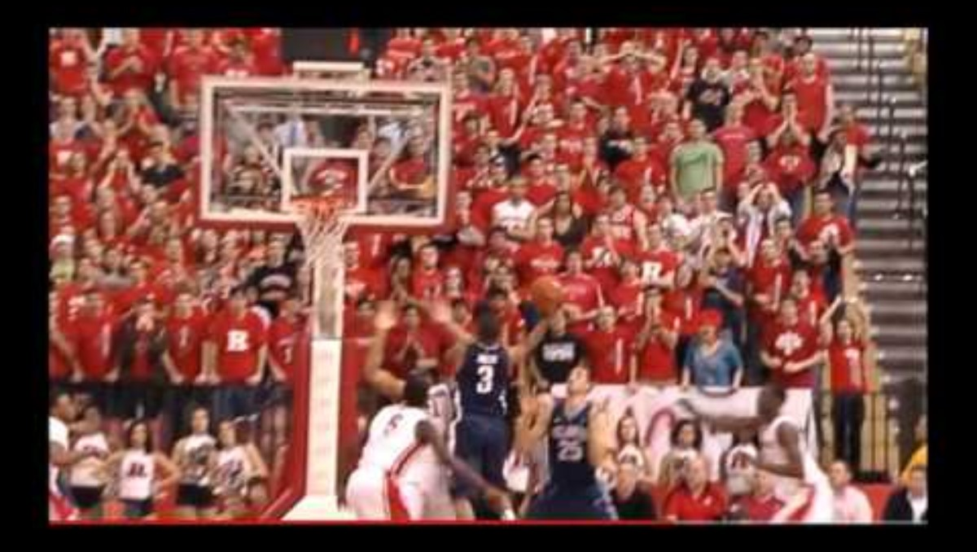

Slide 32
What happened on this play?
What should the officials do on this play?
Play should have been stopped and called a shot clock violation. It’s clearly a shot clock violation once the ball is rebounded by the shooting team. This should be waved off and no goal awarded. If the ball clearly hits the rim, then play-on, but be sure.
What should the Shot Clock Operator do on this play?
The shot clock operator should not do anything here. Let the shot clock horn/buzzer sound until its clear the goal is good and or the officials have decided to let the play continue.

Slide 33
ANY QUESTIONS??

